Slide 1
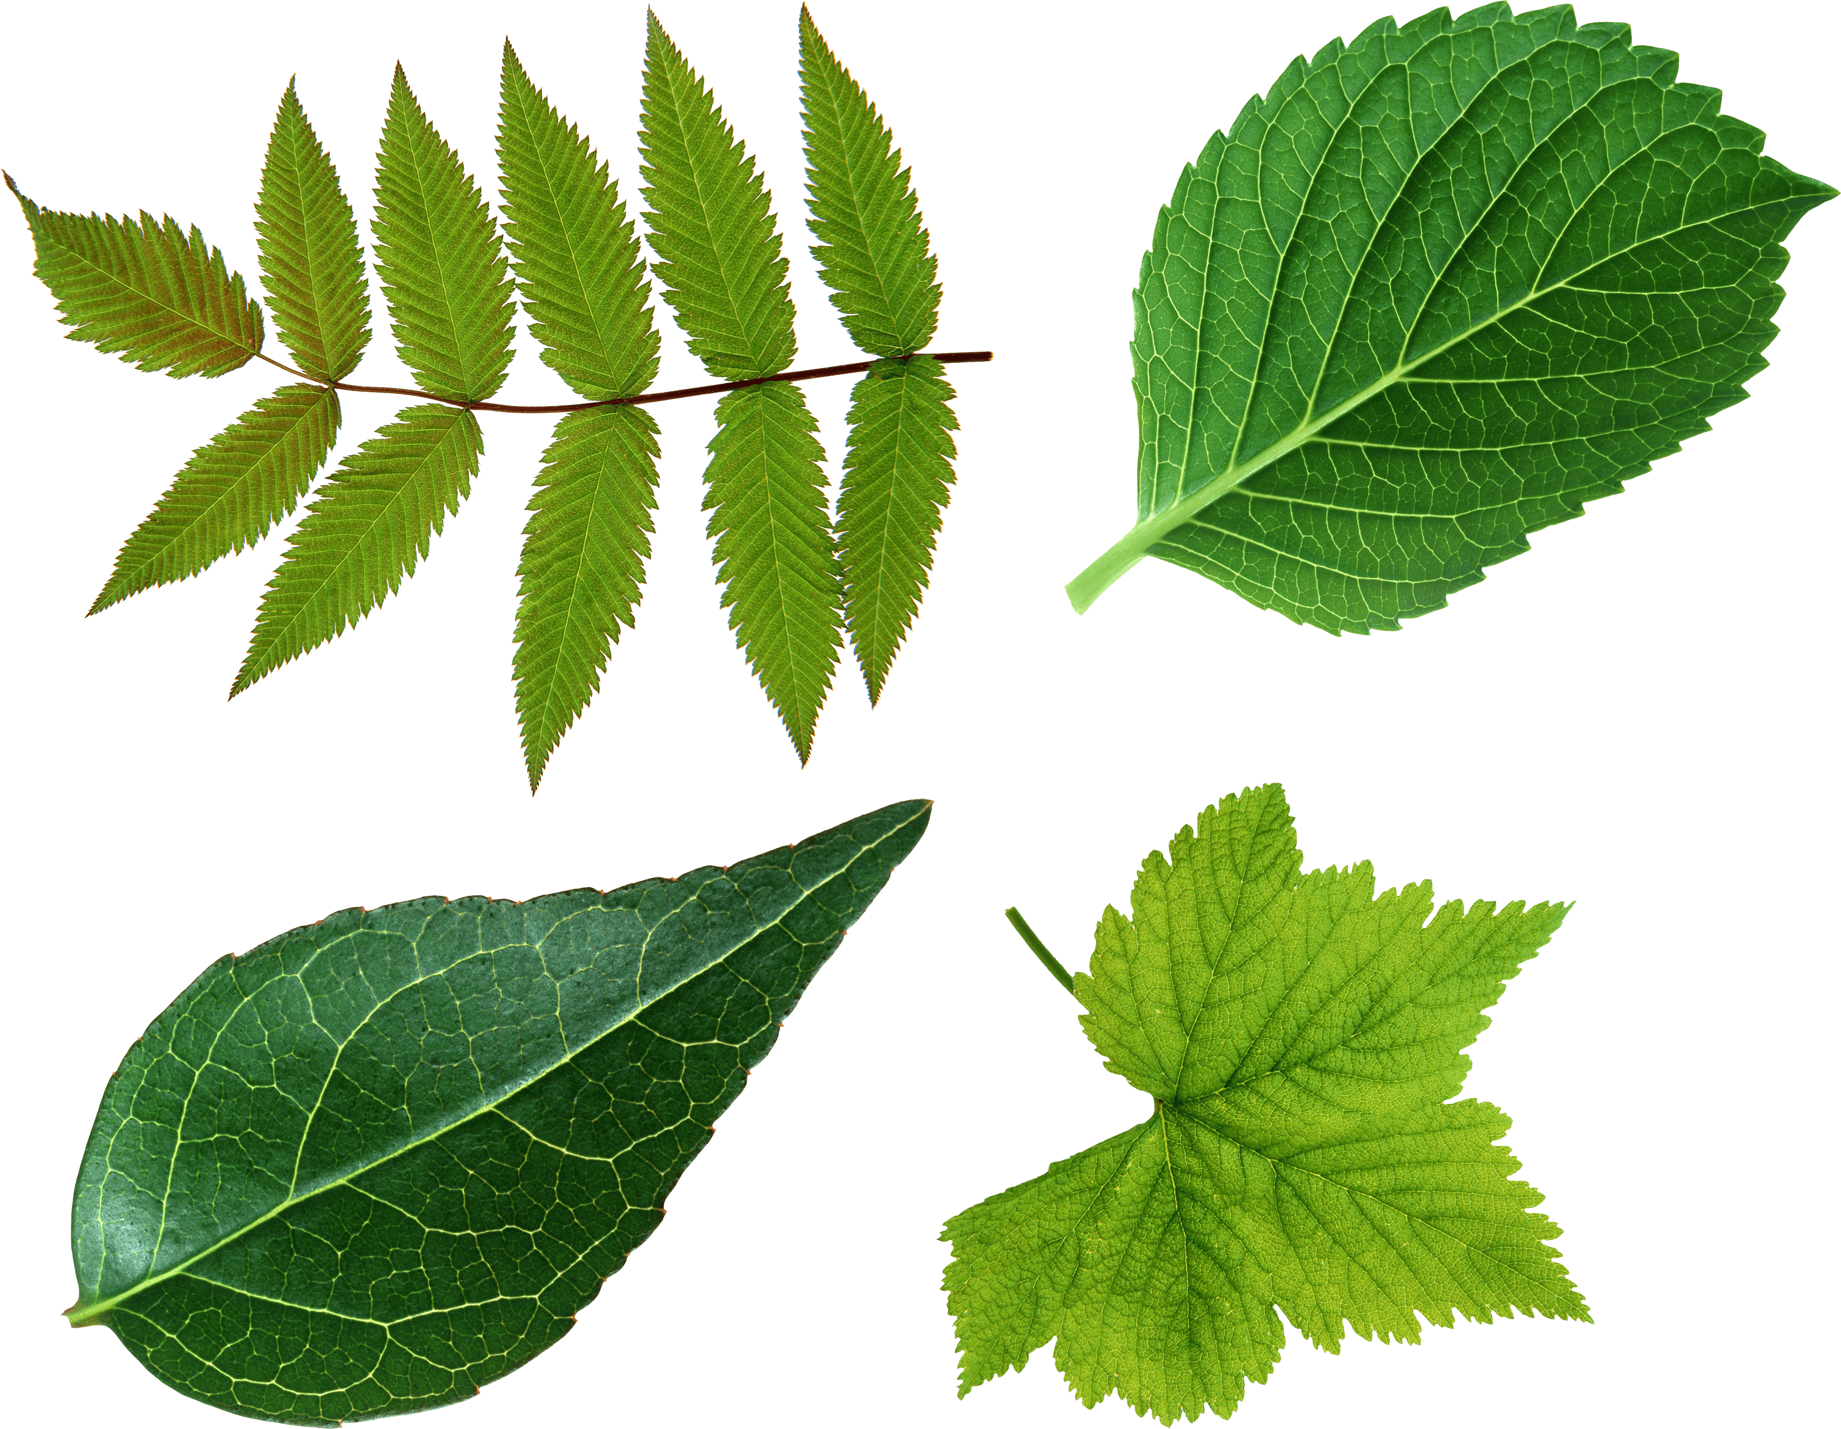
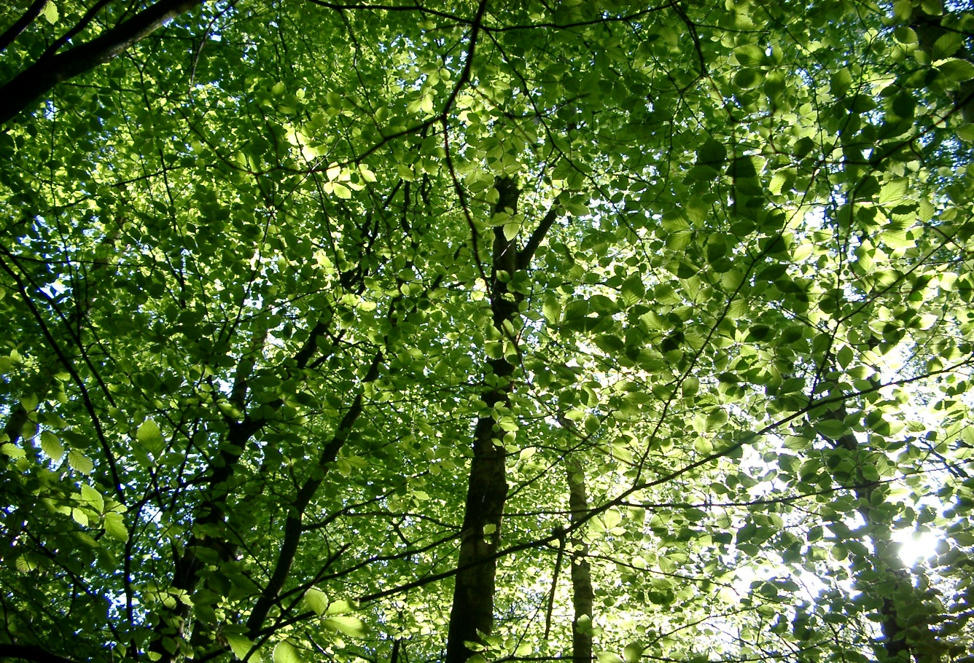
DETECTION OF FLORAL LEAF AFFLICTION USING IMAGE PROCESSING TECHNIQUES

Slide 2

GROUP GUIDE :MANJUSHA SANKE GROUP MEMBERS : 1. ABHIJEET SINGH(I17-01) 2. KARAN PANCHAL(I18-09) 3. OMKAR PRABHUDESAI(I16-47) 4. ADITI SAWANT(I18-13)

Slide 3

PROBLEM STATEMENT :
The main purpose is to detect the diseased part of the plant by finding the optimum way with minimum cost.
Now a days its very costly to afford treatment of plants and crop diseases.
Its difficult to identify multiple diseases altogether.
In this problem we can find 2 categories of the plant leaf disease which are :
Healthy and Disease.

Slide 4

OBJECTIVE :
For our proposed solution we identify the affected area and identify the disease. Our approach is to provide the result in minimum time span with maximum precision and accuracy in comparison to other existing approaches.
To apply and implement the new algorithm to monitor the growth of the crop and detect the diseased part in the plant.
To incorporate the global optimization strategy for enhancing the optimal solution.
To modify the existing solution more efficiently to solve this problem is more genuine way.

Slide 5

INTRODUCTION :
Fundamental knowledge we need to know:
Image Definition : Image is a collection of pixels or dots which are stored in rectangular array.
Semantic Network : Semantic network also termed as neural networks consist of layer of connected nodes like neurons in brain used for computing purposes.
Identifying Pattern : In order to detect the same kind of pattern different pattern recognition techniques are used.
Using these techniques we recognize the similar kind of the pattern in the problem

Slide 6
BLOCK DIAGRAM :

Slide 7

LITERATURE SURVEY :
S.NO | PAPER NAME | AUTHOR | YEAR | OBJECTIVE | METHODOLOGY | FINDINGS
1. | Detection of plant leaf diseases using image segmentation and soft computing techniques | Vijai Singh A.K. Misra | 2016 | This paper monitor the crop growth using the image segmentation techniques. Noise filtering is done and features are extracted and then image is further classified to detect the diseased part. | • Support Vector Machine (SVM) • Artificial Neural Network (ANN) • Dispersion method • Self-sorting out element | Using image segmentation techniques and machine learning algorithms the information for ripening stages of crop and infected part recognition is made.
2. | Remote Area Plant Disease Detection Using Image Processing | Sabah Bashir Navdeep Sharma | 2012 | Infected part in the plant can be detected with help of color, and other changing properties by using classification algorithm. | • Segmentation • RGB • Colour transformation • Image acquisition • classification | Different pixel information is extracted and Green leaves pixel and diseased leaf pixel are compared by finding the ratio of pixel corresponding to the healthy leaf to the pixel corresponding to the infected leaf. Background is remove and different region of the images are formatted after the image acquisition.

Slide 8
S.NO | PAPER NAME | AUTHOR | YEAR | OBJECTIVE | METHODOLOGY | FINDINGS
3. | Smart Farming: Pomegranate Disease Detection Using Image Processing | Manisha Bhangea H.A.Hingoliwala | 2015 | The paper provides the image processing techniques and the algorithm which help the farmers to successfully identify the disease in pomegranate. Image acquisition and image processing of the input image is done using the filter commands in the MATLAB by pixel values of the input image gets more clarified and the disease which is present in the pomegranate is successfully detected. The approach also provide user two different options that is with intent search and without intent search. | • Image pre-processing • Feature extraction • Morphology • Colour Coherence Vector (CCV) • Clustering • Training and classification • Intent search | Remote area farmer can also identify the disease in the pomegranate crop as this algorithm gives user option with and without intent. It let the user to upload the image in the system for further processing. This approach is very effective.
4. | Machine Learning for High-Throughput Stress Phenotyping in Plants | Arti Singh, Baskar Ganapathysubramanian, Asheesh Kumar Singh Soumik Sarkar | 2016 | The aim of this paper is to give us an overview regarding the work done in the field of plant stress phenotyping using Machine Learning, classification, quantification and prediction. It will also tell about the general issues in Machine Learning strategy. | • High-throughput phenotyping (HTP) • High-throughput stress phenotyping (HTSP). • ML algorithms • Support vector machines (SVM) • Artificial Neural Networks(ANN) | The concepts discussed here can be applied to data collected across the spectrum of complexity and sophistication.It helped us to identify several future avenues for using ML techniques that show tremendous promise but remain currently unutilized by the phenotyping community.

Slide 9
S.NO | PAPER NAME | AUTHOR | YEAR | OBJECTIVE | METHODOLOGY | FINDINGS
5. | Image pattern classification for the identification of disease causing agents in plants | A.Camargo J.S.Smith | 2009 | The aim of this paper is to do the automatic identification of the plant disease by image processing from the visual symptoms by analyzing the colored images. | • Image pre-processing • Image enhancement • Image segmentation • Image post-processing | The test set consisted of 20 images which were showing symptoms of plant disease in different crops used in the study. To create the manually segmented set of images, a grid was overlaid on the image and each position was then evaluated the white color and black color. White color (1)depicted the pixel having diseased symptoms whereas the black (0) for non diseased region.
6. | Leaf Disease Detection using Image Processing. | Sujatha R Y Sravan Kumar Garine Uma Akhil | 2017 | This study summarizes major image processing used for identification of leaf diseases are k-means clustering, SVM. This approach can significantly support an accurate detection of leaf disease | Image Acquisition Image pre-processing Image segmentation Feature Extraction in Image Detection And Classification of the diseases | By using this concept the disease identification is done for all kinds of leafs and also the user can know the affected area of leaf in percentage by identifying the disease properly the user can rectify the problem very easy and with less cost. .

Slide 10
S.NO | PAPER NAME | AUTHOR | YEAR | OBJECTIVE | METHODOLOGY | FINDINGS
7. | Leaf Disease Detection using Image Processing. | Ashwini C Anusha B Divyashree B R Impana V Nisarga S P | 2020 | This project proposed to point out disease in the leaf with a union of shape, texture and color feature withdrawal. | Image Acquisition Image Sharpening Edge Detection Greyscale Image Adaptive Histogram Equalization Shape, Color and Texture Features Support Vector Machine(SVM) | Initially the farmers sends a digital image of the diseased leaf of a plant and these images are read in MATLAB and processed automatically based on SVM.
8. | Plant diseases and pests detection based on deep learning. | Jun Liu Xuewei Wang | 2021 | Plant diseases and pests identification can be carried out by means of digital image processing. | Using network as feature extractor Using network for classifcation directly Using network for lesions location Detection network | Deep learning technology has made some achievements in the identifcation of plant diseases and pests.Various image recognition algorithms have also been further developed and extended, which provides a theoretical basis for the identifcation of specifc diseases and pests.

Slide 11
S.NO | PAPER NAME | AUTHOR | YEAR | OBJECTIVE | METHODOLOGY | FINDINGS
9. | Using Deep Learning for Image Based Plant Disease Detection | Sharada P.Mohanty David P. Hughes Marcel Salathé | 2016 | This project proposed to point out disease in the leaf with a union of shape, texture and color feature withdrawal. | Leaf disease detection by well-known deep learning Architecture. New/modified dl architectures for leaf-disease detection. The system of leaf-disease detection | The approach of training deep learning models on increasingly large and publicly available image datasets presents a clear path toward smartphone-assisted crop disease diagnosis on a massive global scale.
10. | Rice disease detection Pattern Recognition techniques | Minu Eliz Pothen Maya L. Pai | 2020 | The point of this paper is to depict a product model framework for the discovery of malady in rice plant based on different pictures of the rice plants. Pictures of the tainted piece of the rice plant are taken utilizing computerized camera. With the end goal to identify the abandoned piece of the plant. | Preparing & design examination strategies of images Binary cut off methods Border layout calculation using eight-availability strategy Self-organizing map(SOM) | The diseased part of the rice plant leaf is identified with the help of the self-organizing map. Testing is done using four different images of the crop. Infected region is extracted using neural networks pattern recognition techniques.

Slide 12
S.NO | PAPER NAME | AUTHOR | YEAR | OBJECTIVE | METHODOLOGY | FINDINGS
11. | Plant disease detection using image processing. | Sachin D. Khirade A.B. Patil | 2015 | The paper provides different types image processing techniques which can directly be implemented in MATLAB for preprocessing of the image and also brief about the image segmentation and image classification. For the feature extraction the paper provide algorithmic methods which can easily calculate shape and color oriented features. | Image pre processing Image enhancement SVM classification Semantic networks K means clustering Neural network based classifier | The feature extraction and the image segmentation algorithm used in this paper are efficient with very high accuracy. Different disease are identified with very high precision rate and accuracy. Clustering algorithm approach is also very much efficient fast, the clustering algorithm segment the image in the different clusters in very short span of time .
12. | Smart Plant Disease Detection System | Bhoopendra Joshi Abhinav Kumar Satyam Kashyap Nooruddin Nagdi Sukhdarshan Vinayak Dinesh Verma | 2021 | The paper deals with association between disease symptoms and impact on product yield. It also deals with the number of training data and testing to accomplish better accuracy. | Data Preprocessing CNN Algorithm | This paper gives the survey on different diseases classification techniques. Tomato, Potato, Pepper-bell are some of those species on which the algorithms and methods were tested.

Slide 13
S.NO | PAPER NAME | AUTHOR | YEAR | OBJECTIVE | METHODOLOGY | FINDINGS
13. | Comprehensive Survey on various Plant Disease Detection Techniques based on Machine Learning | Anchal Chaudhary Vimal Kumar | 2020 | Image processing is the mechanism used to calculate and evaluate the amount of infectious part and determines the change in shade of that affected part. | Plant diseases recognition is the mechanism having three stages: The images are fed into the terminal for pre-processing. The images are analyzed according to the segmentation features. Classification of the picture is performed by employing some desired classification model. | In this paper they calculate the digital image processing for the detection, diagnosis, reorganization of the crop leaf infections based on the usage of the k-means clustering technique and it also increases the accuracy.
14. | An Overview of the Research on Plant Leaves Disease detection using Image Processing Techniques. | Ms. Kiran R. Gavhale Prof. Ujwalla Gawande | 2014 | The objective of this paper is to concentrate on the plant leaf disease detection based on the texture of the leaf. Leaf presents several advantages over flowers and fruits at all seasons worldwide. | RGB image acquisition Convert the input image into color space Segment the components Obtain the useful segments Computing the texture features Configuring the neural networks for recognition. | These techniques are used to analyses the healthy and diseased plants leaves.

Slide 14
S.NO | PAPER NAME | AUTHOR | YEAR | OBJECTIVE | METHODOLOGY | FINDINGS
15. | Detection of unhealthy region of plant leaves and classification of plant leaf diseases using texture features | Arivazhagan Selvaraj Newlin Shebiah | 2013 | detection and classification of leaf diseases has been proposed. | HSI Colour co-occurrence matrix texture features SVM | An application of texture analysis in detecting and classifying the plant leaf diseases has been explained in this paper. The experimental results indicate the proposed approach can recognize and classify the leaf diseases with a little computational effort.

Slide 15

TECHNOLOGIES:
SOFTWARE :
Google Colab

Slide 16

HARDWARE:
LAPTOP :
Operating Systems : Windows 10
Processor : Any Intel or AMD x86-64 processor with four logical cores and AVX2 instruction set support
Disk : 500 GB and above
RAM : 8 GB and above

Slide 17
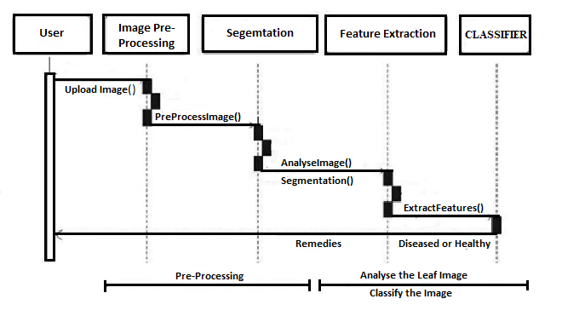
DESIGN PHASE : Sequence Diagram:
Sequence diagrams: They are sometimes called event diagrams or event scenarios.
A sequence diagram shows as parallel vertical lines (lifelines), different processes or objects that live simultaneously and as horizontal arrows, the messages exchanged between them in the order in which they occur.
Fig. Sequence Diagram

Slide 18
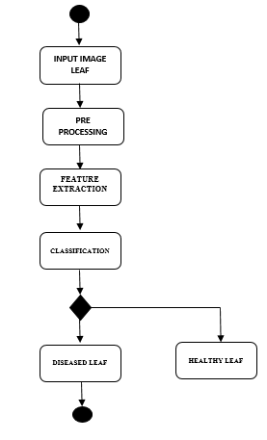
Activity Diagram:
Activity diagram is another important diagram in UML to describe dynamic aspects of the system. Activity diagram is basically a flowchart to represent the flow from one activity to another activity. The activity can be described as in operation of the system. The control flow is drawn from one operation to another.
Fig.- Activity Diagram

Slide 19
ALGORITHMS:
IMAGE ACQUISITION
Image acquisition means to collect different type of samples for the formation of the input dataset.
In order to provide best solution to any problem it is necessary that dataset cover majority of the different type of inputs.
Different image formats are taken in our dataset.
Any other image excluding dataset can be used in our algorithm provided its size is matching and format is known, our algorithm and its classifier gives the prediction of the disease for that random image.

Slide 20
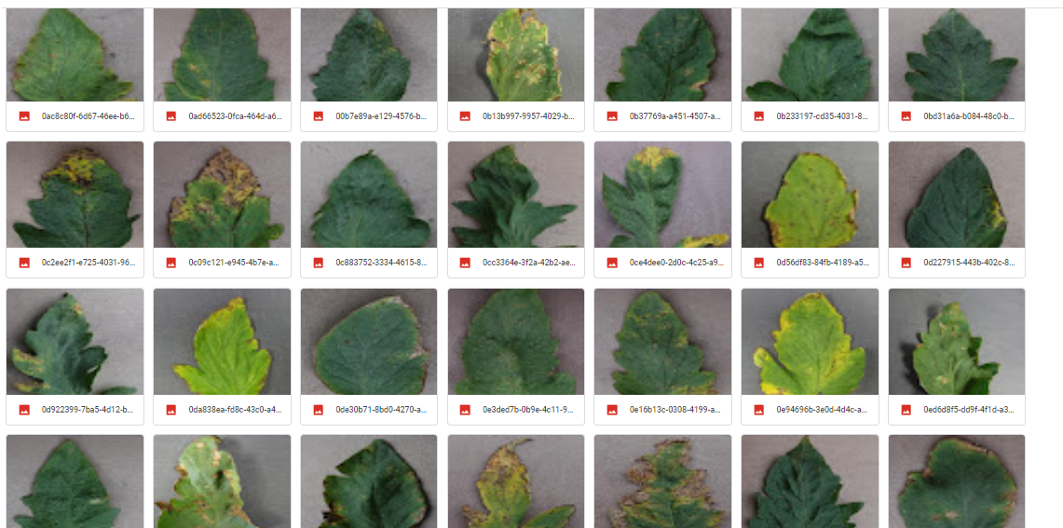
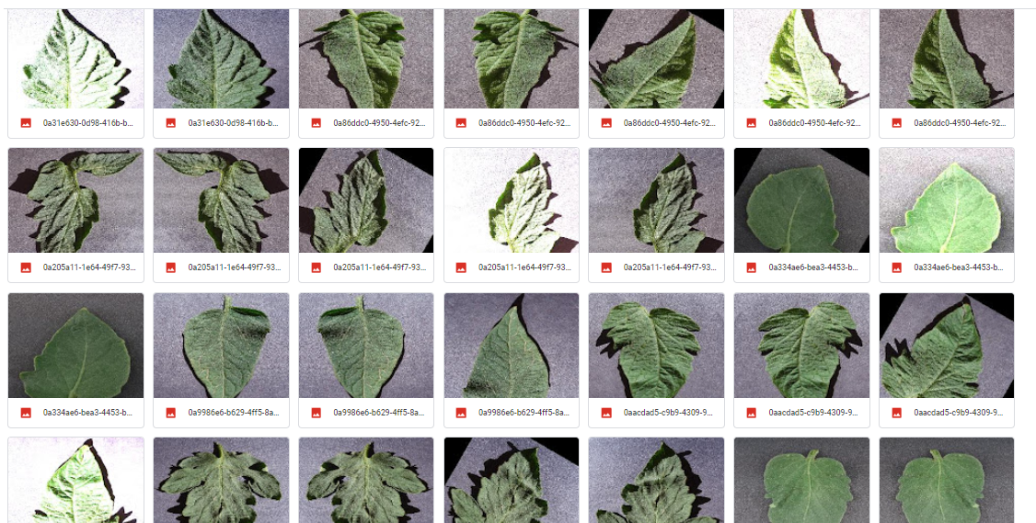
Fig . Training Dataset (Disease Leaf )
Fig. Training Dataset (Healthy Leaf)

Slide 21
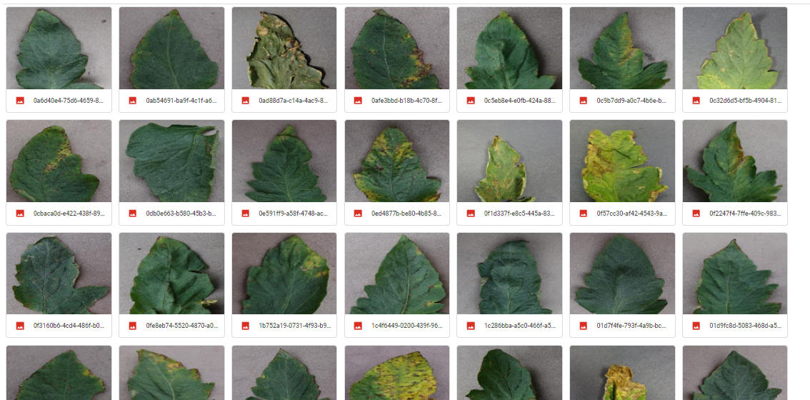
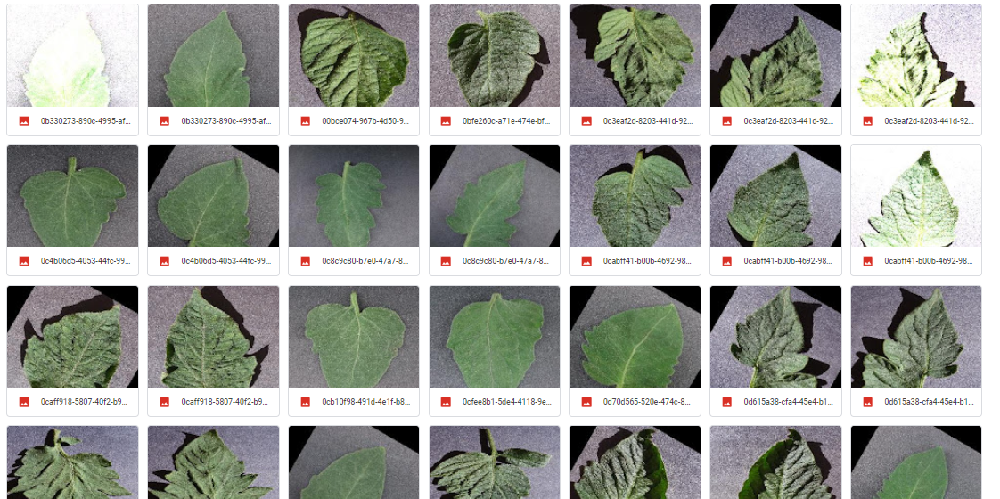
Fig. Validation Dataset (Diseased Leaf)
Fig. Validation Dataset (Healthy Leaf)

Slide 22
IMAGE PREPROCESSING
The purpose of the image preprocessing and enhancement step is that after preprocessing the image its get easy to separate the infected area.
Indirectly the classifier we use works better with preprocessed image and without impurities. Values of the pixels also get adjusted in the preprocessed image.
The database is preprocessed such as Image reshaping, resizing and conversion to an array form. Similar processing is also done on the test image.

Slide 23
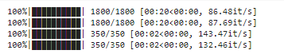
Model training and Testing
Loading the Dataset
The training dataset is used to train the model (CNN) so that it can identify the test image and the disease it has. CNN has different layers that are Dense, Dropout, Activation, Flatten, Convolution2D, and MaxPooling2D. After successful training and preprocessing, comparison of the test image and trained model takes place to predict the disease.
Create the Model
CNN model - Efficientnetb7 model
CNN is a type of artificial neural network used to interpret visual imagery in deep learning. Shift invariant or SIANN are built on the shared-weight architecture of convolution kernels or filters that slide along input features and produce translation equivariant outputs known as feature maps.

Slide 24
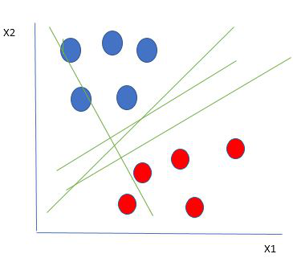
CLASSIFICATION
SVM(SUPPORT VECTOR MACHINE)
Support vector machines (SVMs) are a new type of statistical learning algorithm that is based on new ideas about how to learn (SVM).This method works with both linear and non-linear data, so it can be used with both types of data. People use support vectors, important training pairs, to move data into a higher dimension so that they can find a hyperplane where the data can be separated. Support vector machines can be formalized by separating hyper planes from each other (SVMs).

Slide 25
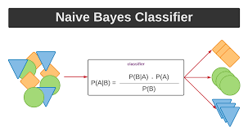
NAIVE BAYES CLASSIFIER (NBC)
Naïve Bayes algorithm is a supervised learning algorithm, which is based on Bayes theorem and used for solving classification problems.
It is mainly used in text classification that includes a high-dimensional training dataset.
Naïve Bayes Classifier is one of the simple and most effective Classification algorithms which helps in building the fast machine learning models that can make quick predictions.
It is a probabilistic classifier, which means it predicts on the basis of the probability of an object.

Slide 26
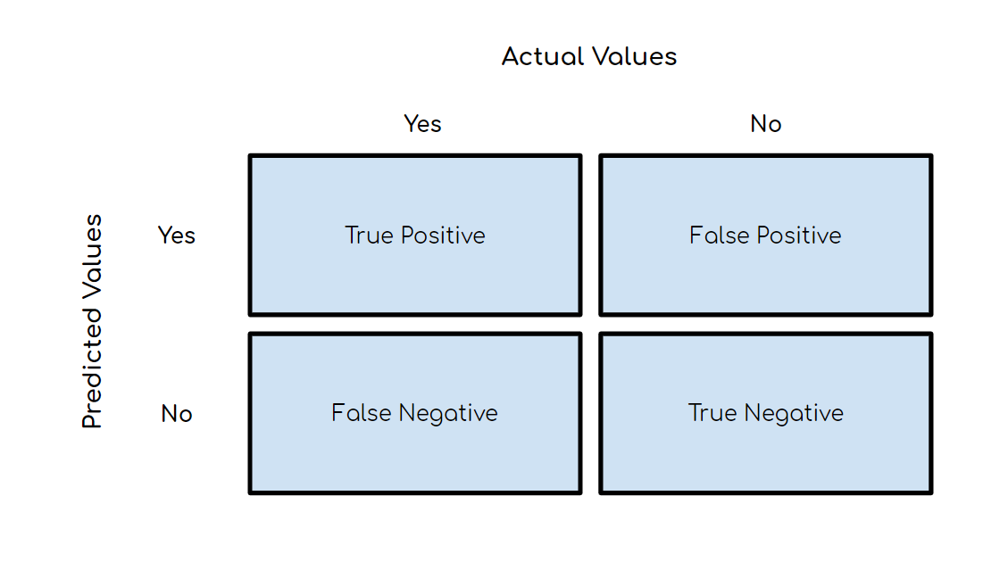
Confusion Matrix:
A confusion matrix, also known as an error matrix, is a summarized table used to assess the performance of a classification model. The number of correct and incorrect predictions are summarized with count values and broken down by each class.
Below is an image of the structure of a 2x2 confusion matrix. To give an example, let’s say that there were ten instances where a classification model predicted ‘Yes’ in which the actual value was ‘Yes’. Then the number ten would go in the top left corner in the True Positive quadrant. This leads us to some key terms:
Fig. Example of Confusion Matrix

Slide 27
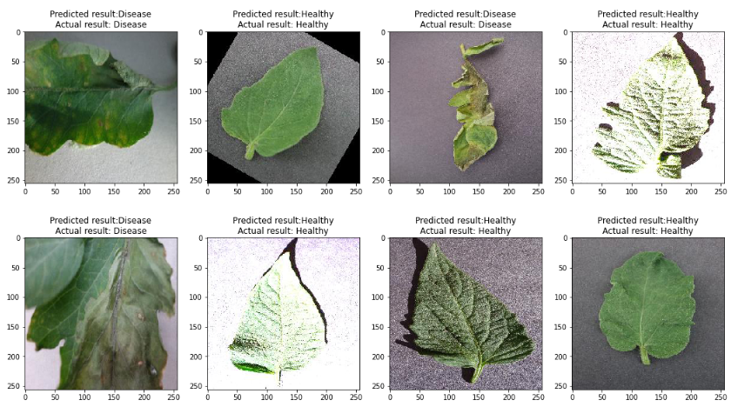
Predicted Image Plot

Slide 28

APPLICATION/USEFULNESS :
Agriculture :Agricultural monitoring to predict the disease of the particular type of the plant which can help to prevent famine and support our Indian farmers before harvesting any plant.
The advantage of using this method is that the plant diseases can be identified at an early stage or the initial stage.
Gardening : A individual who has very rudimentary knowledge regarding the plant diseases, can simply with a single click of a photograph of the plant can find out the affliction which is plaguing his/her plant and find remedy for them.
Green House: The relatively closed environment of a greenhouse has its own unique management requirements, compared with outdoor production. Pests and disease, and extremes of temperature and humidity, have to be controlled, and irrigation is necessary to provide water.

Slide 29
Conclusion:
In this project work the area of plant disease recognition is introduced. In this project, a deep learning model is trained using CNN technique for detection and classification of leaf disease. Using image processing and machine learning, we successfully identified the affected area in the plant leaf. Various features of the image are extracted with their numeric values. The algorithm used here is highly efficient and best-case time space complexities are achieved. Average accuracy of ninety plus percentage is achieved in every query image of the dataset.

Slide 30
Future Scope:
Our Project can be further expanded for other commercial crops.
Pre detection of diseases will help to reduce the lost as well as amount of the damage caused by the leaves.
This can even be applied to the large data stored in agriculture department thus leading to better results and faster finding.
Mobile application can be developed which is handy and easy to use.
An extension of this work will focus on automatically estimating the severity of the detected disease.
As future enhancement of the project is to develop the open multimedia (Audio/Video) about the diseases and their solution automatically once the disease is detected.
Web based image processing techniques can be implemented. In this user can be provided with two modes with and without internet.
In case of web base processing, remote area users can upload image in the system and whole image system techniques and classification algorithm can be implemented in the cloud itself.

Slide 31

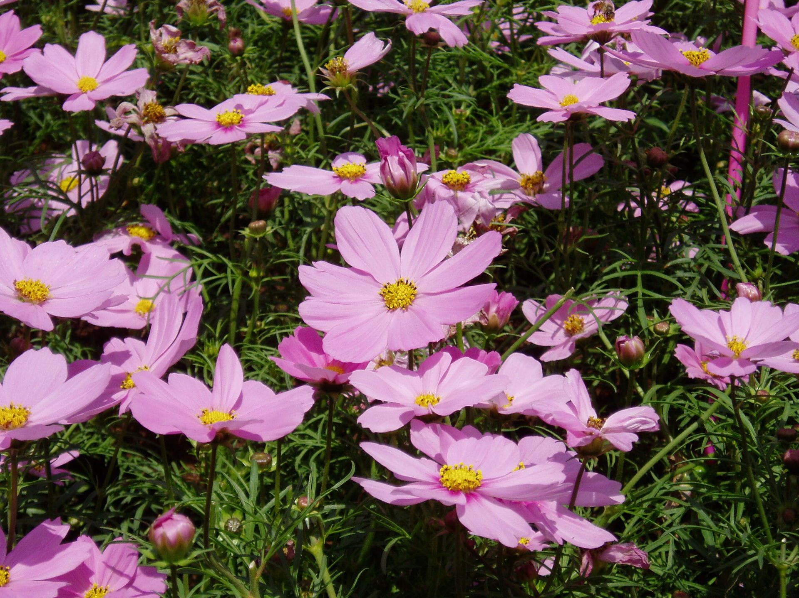
THANKYOU

